Slide 1
Module 6: Tests of Hypothesis

Slide 2
Contents
Null and Alternative hypotheses
Types of errors
Neyman–Pearson lemma
Most Powerful (MP) and Uniformly Most Powerful (UMP) tests.

Slide 3
Introduction to Hypothesis Testing
Hypothesis testing is one of the most important concepts in statistics.
Heavily used by Statisticians, Machine Learning Engineers, and Data Scientists.
Statistical tests are used to check whether a null hypothesis is rejected or not rejected (accepted).
Statistical tests assume a null hypothesis of no relationship or no difference between groups.

Slide 4
Definition
A hypothesis is defined as a formal statement,
which gives the explanation about the relationship between two or more variables of a specified population.
Example: Based on sample data, we may wish to decide whether a serum is really effective in curing Corona.

Slide 5
Types of hypothesis
Simple
Complex
Null
Alternative
Empirical
Statistical

Slide 6
What is test of hypothesis?
Assume that a particular hypothesis is true, we find that results observed in a random sample differ markedly from those expected. We say that observed differences are significant and we reject the hypothesis.
Procedures that enable us to decide to accept or reject hypothesis are called test of hypothesis, test of significance, decision rules.

Slide 7
Type I & Type II errors
Type I error: Rejecting a hypothesis when it happens to be true.
Type II error: Accepting a hypothesis when it is to be rejected.
These errors have to be minimized, but the decrease in one causes the increase in the other.
The best solution is to increase the sample size.

Slide 8
Characteristics of hypothesis
The important characteristics of hypothesis are:
It should be short and precise.
It should be specific.
It must be related to the existing body of knowledge.
It should be capable of verification.

Slide 9
Statistical hypothesis
It is a guess or assumption about the parameters of population distribution.
It is established beforehand and may or may not be true.
Statistical hypothesis can be either
Null hypothesis (H₀)
Alternative hypothesis (H₁) or (H_{a})

Slide 10
Null Hypothesis (H₀)
It is a statistical hypothesis which is to be actually tested for acceptance or rejection.
It is a hypothesis which is tested for possible rejection under the assumption that it is true.
It is expressed in the form of equality.
Example: Independent variables have no effect on the dependent variables.

Slide 11
Examples of Null Hypothesis (H₀)
Null hypothesis is always a simple hypothesis stated as an equality specifying an exact value of the parameter.
Examples:
Population mean equals to a specified constant µ₀
The difference between the sample means equals to a constant.

Slide 12
Alternate Hypothesis (H₁) or (H_{a})
It is any other hypothesis other than null hypothesis (H₀)
It is expressed in the form of >,<, not =
We can accept alternative hypothesis if there is sufficient evidence.
This was originated by Neyman.
Example: Independent events or variables have effect on dependent variables.
H₁: µ> µ₀

Slide 13
Critical Region
In any test of hypothesis, a test statistic S*, calculated from the sample data, is used to accept or reject null hypothesis of the test.
The area under the probability curve of the sampling distribution of the test statistic S* which follows some known given distributions.
This area under probability curve is divided into two regions, region of rejection where null hypothesis is rejected and region of acceptance.

Slide 14
The critical region is the region of rejection of null hypothesis.
The area of critical region equals to the level of significance (α).
Critical region lies on the tail(s) of the distribution.
Depending upon the nature of alternate hypothesis (H_{a}), critical region may lie on one side or both sides of the tail(s).

Slide 15
Test of Significance
This is the procedure to decide whether to
accept or reject null hypothesis (H₀).
This test is used to determine whether observed samples differ significantly from expected results.
Acceptance of hypothesis merely indicates that the data did not give sufficient evidence to reject the hypothesis.

Slide 16
However rejection of hypothesis is a firm conclusion that the sample evidence rejects it.
When null hypothesis (H₀) is accepted, the result is said to be non-significant, which means the observed differences are due to chance caused by the process of sampling.
When null hypothesis (H₀) is rejected, which means the alternate hypothesis (H₁) is accepted and the result is said to be significant.
Since the test is based on sample observation, the decision of acceptance or rejection of null hypothesis is subject to some error or risk.

Slide 17
Level of Significance (α)
Represented by α.
This is the probability of committing Type I error.
It measures the amount of risks associated in taking decisions.
This factor has to be chosen before sample information is collected.
It is either 0.01 or 0.05.

Slide 18
How to compute the level of significance?
To measure the level of statistical significance of the result, the investigator first needs to calculate p-value.
It defines the probability of identifying an effect which provides that null hypothesis (H₀) is true.
When p-value is less than the level of significance (α), the null hypothesis is rejected.

Slide 19
Interpretation of p-value based on level of significance (10%)
If p > 0.1, then there will be no assumption for null hypothesis
If p > 0.05 and p ≤ 0.1, it means that there will be a low assumption for null hypothesis.
If p > 0.01 and p ≤ 0.05, then there must be a strong assumption about null hypothesis.
If p ≤ 0.01, then a very strong assumption about null hypothesis is indicated.

Slide 20
Rejection rule of Null Hypothesis (H₀)
If p < α, then one must reject null hypothesis
If p > α, then one should not reject (i.e., accept) null hypothesis.

Slide 21
Power of test
α probability of committing Type I error
= P(reject H₀/H₁)
and β probability of committing Type II error
= P(accept H₀/H₁)
Power of test = (1-β)

Slide 22
Critical values or significant values
It is the value of test statistic S_{a}* which separates the area under the probability curve into critical region and non-critical region.
Note: Critical region is the rejection region, non-critical region is the acceptance region.

Slide 23
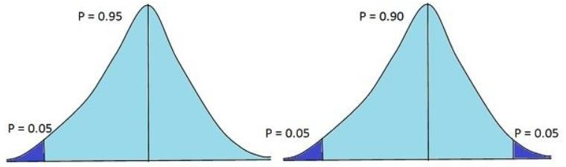
One-tailed test and two-tailed tests

Slide 24
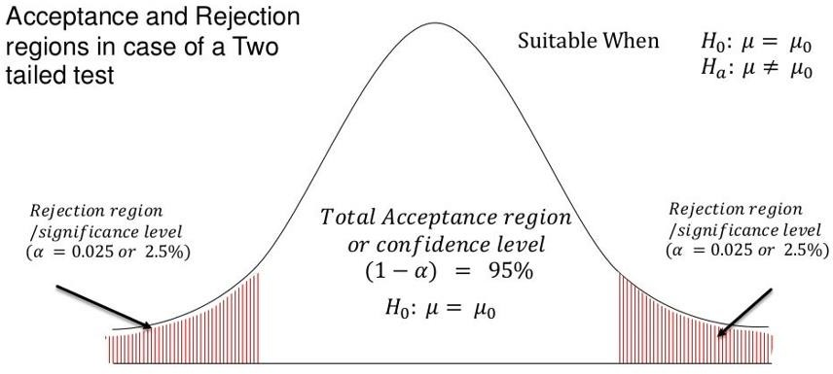
Two-tailed test

Slide 25
One-tailed test
One-tailed test can be right one-tailed test and left one-tailed test.
When the alternative hypothesis is of the greater than type H_{a}: µ>µ₀, then the entire critical region of area α lies on the right side of the curve.

Slide 26
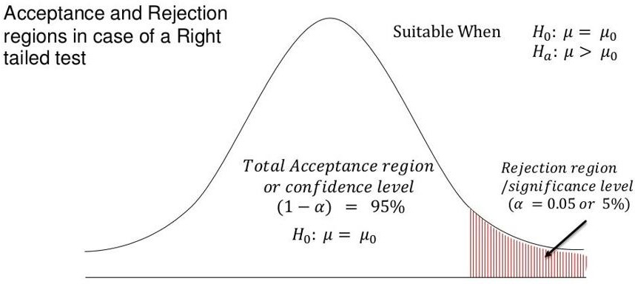
One-sided (right tailed) test

Slide 27
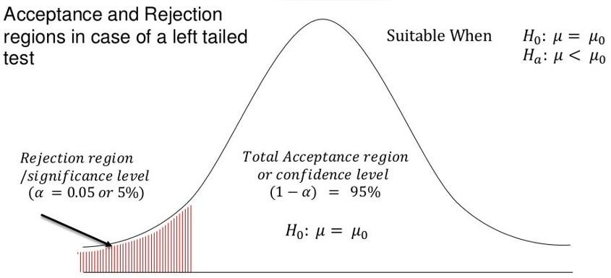
One-sided (left tailed) test
When the alternative hypothesis is of the less than type H_{a}: µ₁<µ₀, then the entire critical region of area α lies on the left side of the curve.

Slide 28
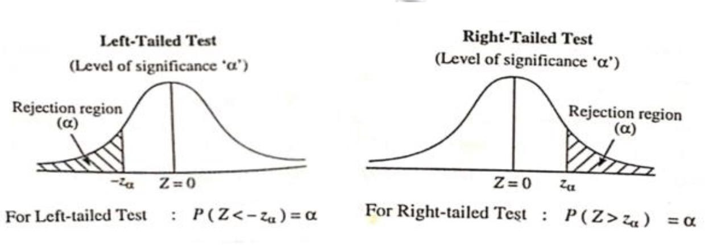

Slide 29
One-tailed test of hypothesis is used when one talks of type I error.
A hypothesis test is also called as one-sided test and is designed to identify a difference from a hypothesized value in only one direction.
It is also called directional test, because it includes the directional prediction in the statement of hypothesis and the location of the critical region.

Slide 30
The critical region for a one-sided test is the set of values less than the critical value of the test or the set of values greater than the critical value of the test
A one-tailed test is one where H₁ is directional and includes < or >
A one-tailed test looks for an increase or decrease in the parameter.
If we reject the null hypothesis at 5% level of significance, then there is significant evidence to reject the hypothesis at 5% level.

Slide 31
Two Tailed Test
If alternative hypothesis is of the not equals type i.e., H₁: µ₁≠µ₂
The critical region lies on both sides of the right and left tails of the curve such that the critical region of area α/2 lies on the right tail and critical region of area α/2 lies on the left tail.

Slide 32
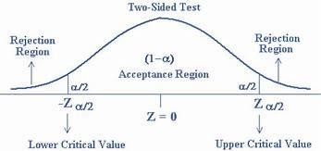
A two-tailed test is one where H₁ has no direction.
The values for which we can reject the hypothesis are located in both tails of the probability distribution

Slide 33
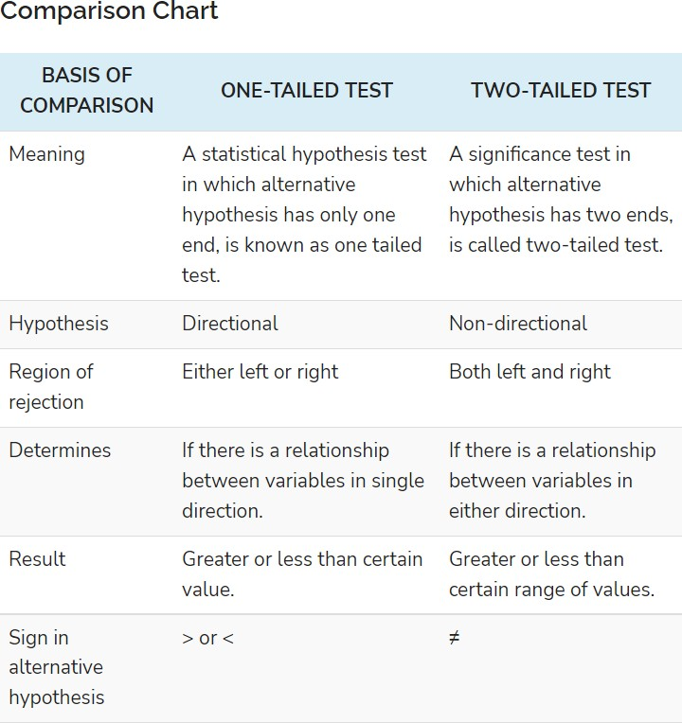

Slide 34
Steps for test of hypothesis
Formulate Null Hypothesis (H₀)
Formulate Alternative hypothesis (H₁)
Choose level of significance α
Critical region (CR) is determined by the critical value S_{a}* and the kind of alternate hypothesis.
Compute the test statistic S* using the sample data.
Decision: Accept or reject H₀ depending on the relation between S* and S_{a}*

Slide 35
Quick revision of Population and Sample
Population: A set or collection or totality of objects under study. Size of population N is the number of objects in the population. Parameters are mean, median, variance.
Sample: Finite subset of population. Size is n. Sample should be a representative of the general population. Done by random sampling.

